Slide 1
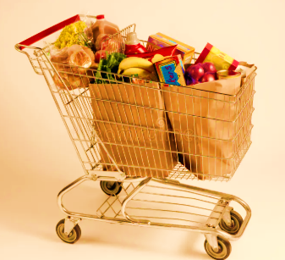
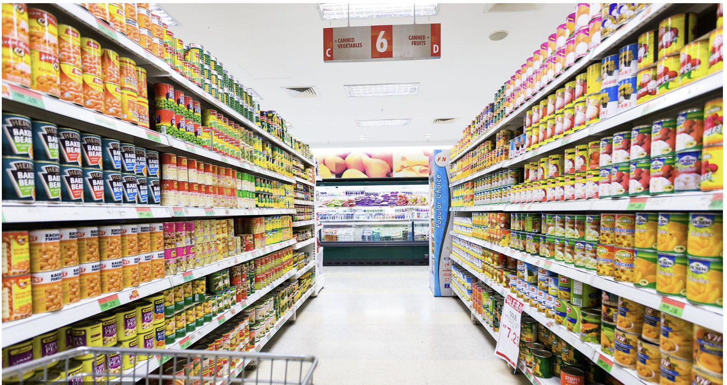
BIMBOLA ADEBAYO
CAPSTONE PROJECT REPORT ON
Instacart Online Grocery Delivery & Pickup Service

Slide 2
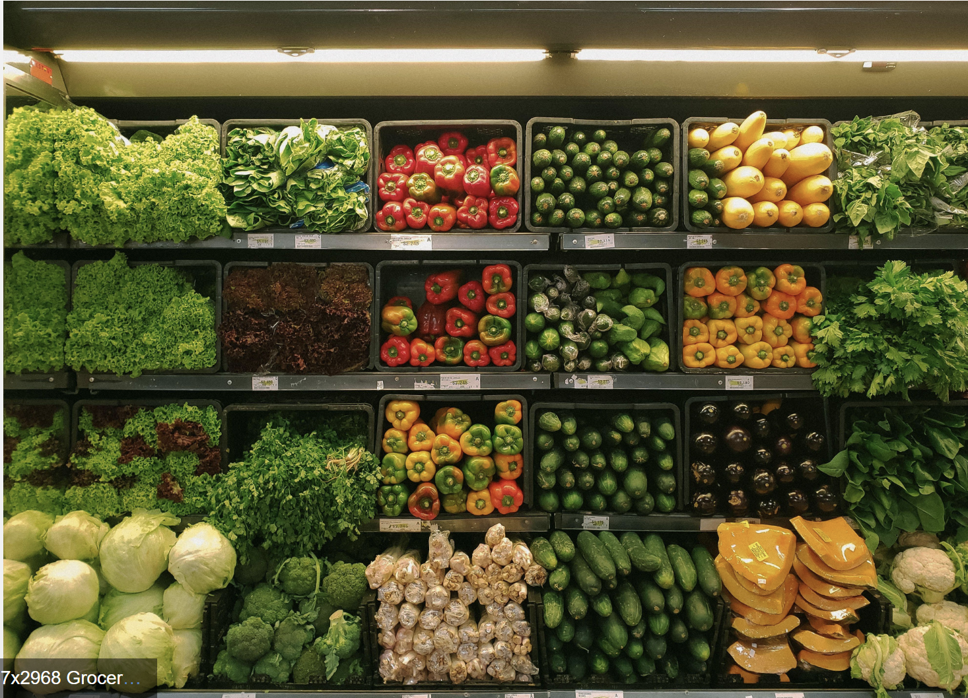
PURPOSE AND SCOPE OF THE PROJECT
The purpose of this project is to analyze Instacart’s operational and sales data to generate actionable insights that support data-driven decision-making. By developing an interactive dashboard, the project aims to help management understand customer behavior, product performance, and overall business trends to improve efficiency and profitability.
Project aim
  Analyzing order, product, aisle, and department data
  Evaluating key metrics such as total revenue, order volume, and customer activity
  Identifying best- and worst-performing products based on sales and profitability
  Examining customer purchasing patterns, including peak shopping times
  Assessing demand versus profitability across aisles and departments

Slide 3
BUSINESS OVERVIEW
Instacart is a leading online grocery delivery and pickup service in North America that partners with retailers to offer same-day delivery. The platform connects customers with personal shoppers who handpick items from local stores.
Problem Statement:
  Management lacks a consolidated view of Instacart’s operational and sales data to make informed decisions.
  Uncertainty exists around product performance, peak demand periods, and underperforming aisles or departments.
  Limited insights hinder effective inventory planning, staffing allocation, and strategies for growth and profitability.

Slide 4
EXECUTIVE SUMMARY
Analysis shows that management should:
  Use insights to optimize product assortment, focusing on high-demand and high-profit items
  Improve inventory planning to reduce stockouts and overstocking
  Align staffing with demand by allocating more resources during peak order hours
  Enhance customer experience through faster delivery and better product availability
  Identify underperforming areas and take action to improve profitability across aisles and departments
  Leverage data to support strategic decision-making and long-term business growth

Slide 5
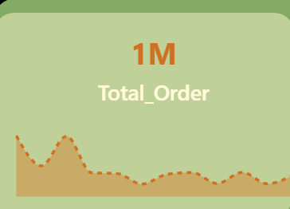
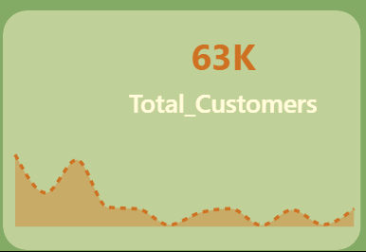
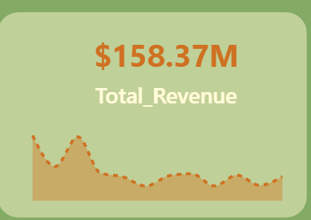
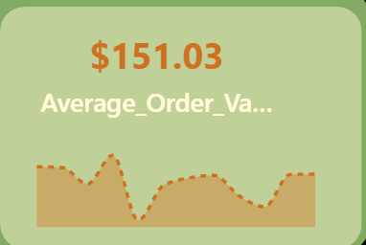
KEY PERFORMANCE INDICATORS
KPIs
Total Revenue: $158.37M
Total Orders: 1M
Total Customers: 63K
Total Average Value: $151.03

Slide 6
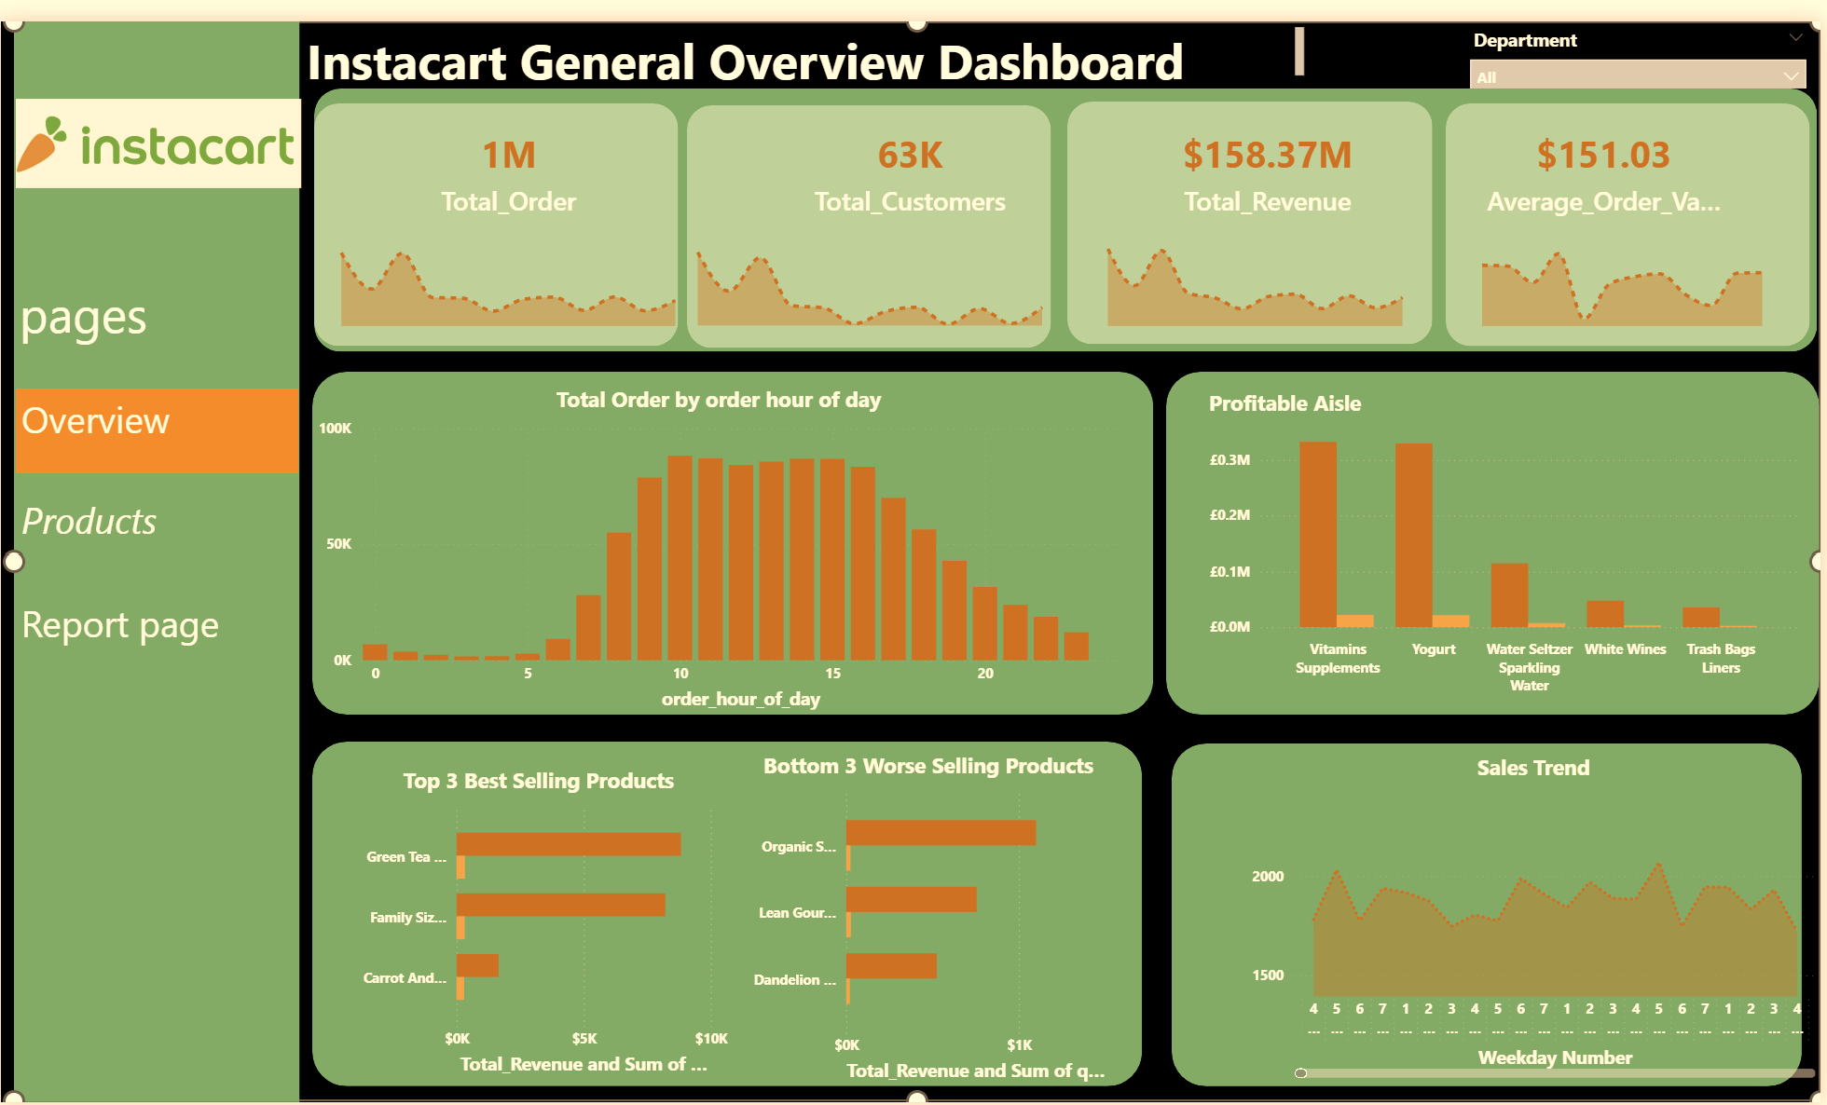
DASHBOARD

Slide 7
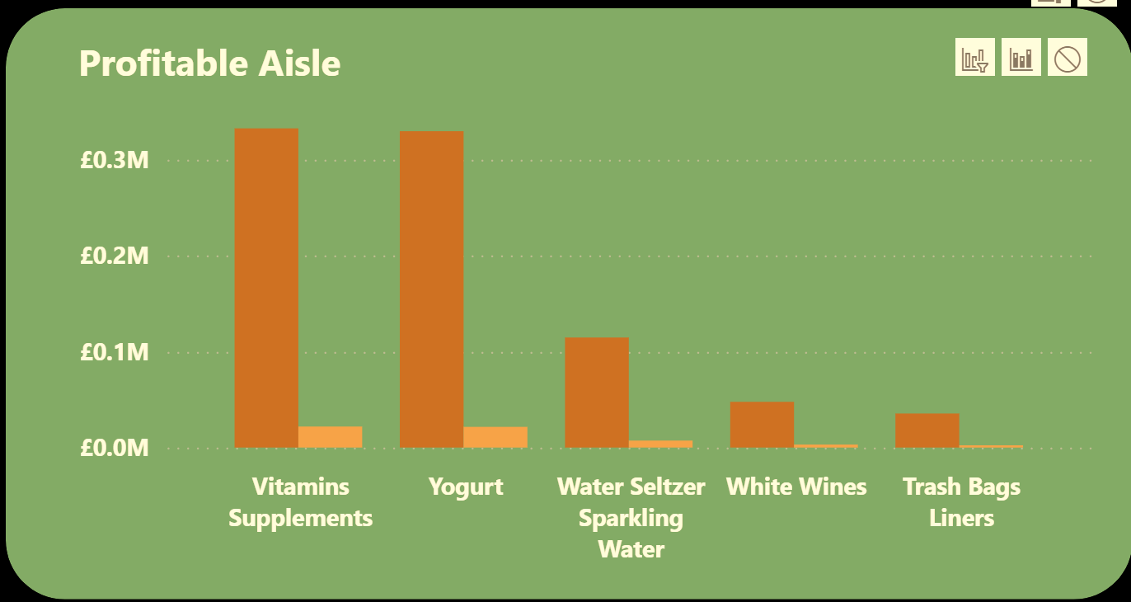
AISLES BY CUSTOMER DEMAND & PROFITABILITY
  High Demand but Declining Profit
  Categories like Vitamins Supplements and Yogurt have the highest order volumes
  However, profit is already starting to decline after these top items
  High sales ≠ high profitability
Demand–Profit Mismatch
  As you move right (e.g., White Wine, Trash Bags ):
  Orders remain relatively stable
  Profit drops significantly
These are also high-demand but low-profit categories

Slide 8
Low Profit Categories
Frozen Meals and Cookies Cakes
  Still decent demand
  But lowest profitability
  Likely due to high costs, discounts, or low margins
Data Quality Issue
  Category labeled “Missing” has very high orders
Business Interpretation
  Your business is strong in demand generation
  But profitability is not optimized across categories
  Some products are being sold a lot but not making enough money

Slide 9
Recommendations
1. Optimize High-Demand, Low-Profit Categories
  Review pricing strategy for: Chips & pretzels, Tea and Packaged cheese
  Reduce unnecessary discounts or supplier costs
2. Focus on High-Profit Opportunities
Double down on categories where:
  Demand is strong
  Profit is still relatively higher (left side of chart) and promote these products more
3. Re-evaluate Low-Profit Items
For Frozen Meals & Cookies Cakes:
  Consider: Price adjustments, Supplier renegotiation, Or reducing promotion focus
4. Bundle Strategy
  Bundle: apply this on High-demand low-profit items- This Increases overall basket profitability

Slide 10
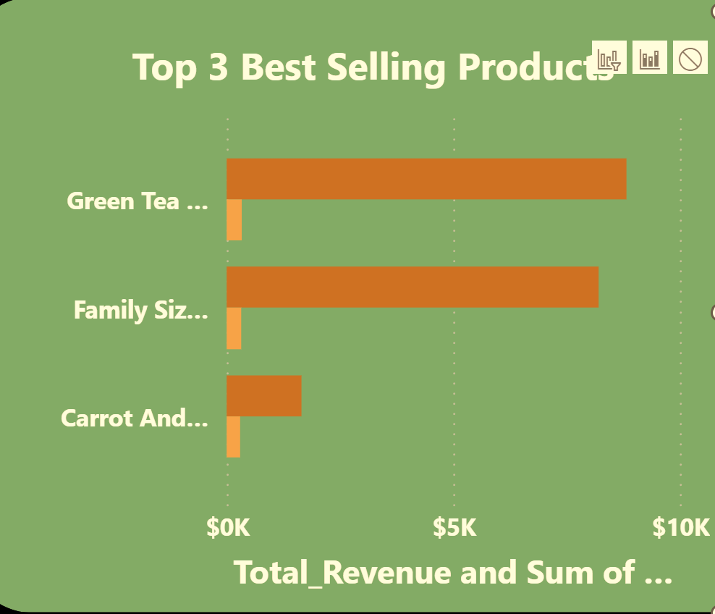
Best and Worst Performing Products
Revenue Analysis
●Green Tea: Highest revenue at $8,823, making it the top performer financially.
●Family Size Lasagna with Meat and Sauce: Very close behind at $8,209, showing strong revenue generation.
●Carrots and Celery Stick: Lower at $1,651, but still significant compared to the others.
From a revenue perspective, Green Tea and Family Size Lasagna are nearly tied, with Green Tea slightly ahead.
Sales Volume (Quantity) Analysis
●All three products show similar quantities sold (0.3K units).
●This suggests that differences in revenue are driven by price per unit, not by volume.

Slide 11
Best Product Cont,n
Insights
●Green Tea: Best overall performer — high revenue with average volume.
●Family Size Lasagna with Meat and sauce: Strong competitor, nearly equal in revenue, also with average volume.
● Carrots and Celery Stick slight difference in sales volume but lower revenue, likely due to lower pricing or smaller margins.
Recommendations
1. Leverage High-Revenue Product
●Promote Green Tea more (ads, bundles)
●Consider: Upselling and Premium positioning
2 Improve Lower Revenue Products
●For Lasagna & Family Size:
-Review pricing strategy
-Reduce unnecessary discounts
-Consider bundling to increase value per order
Strategic Takeaway
If the goal is maximizing revenue, focus on Green Tea and Family Size Lasagna

Slide 12
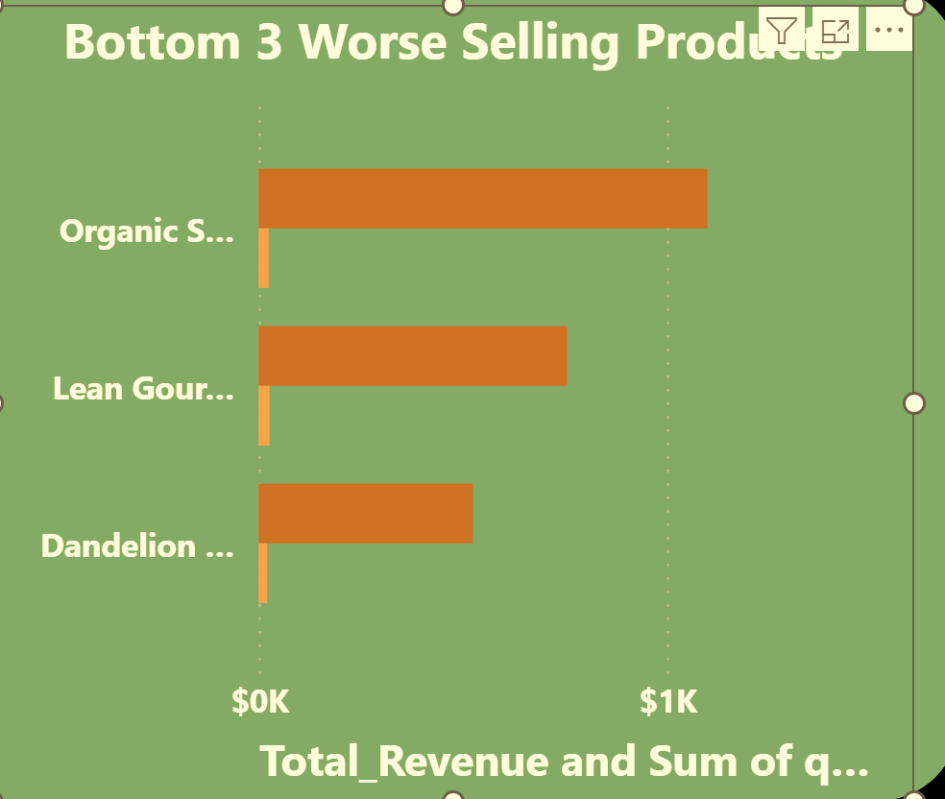
Worst Performing Products
Key Insights
1. Organic Sweet Apple Chicken Sauce (Top among bottom)
●Revenue: $1,100
●Quantity: 25units
Insight: This is the best of the worst — relatively decent demand but still low revenue overall.
2. Lean Gourmet Teriyaki Chicken
●Revenue: $756
●Quantity: 27units
Insight:
●Higher demand than Organic Sweet Apple Chicken Sauce
●Over 34% lower revenue
This strongly suggests: Lower pricing, heavy discounts, or lower perceived value
3. Dandelion Green Juice(lowest performer)
●Revenue: $525
●Quantity: 21 units
Insight: Lowest demand and revenue, this is s true underperformer

Slide 13
Worst Products Cont’n
Recommendations
1. Fix Pricing Strategy
.Review Dandelion Green Juice pricing
.If price is too low → increase slightly
.If discounted heavily → reduce discounts
2. Boost Visibility & Demand
For all three products:
●Improve:
.Product placement (app/store visibility)
.Promotions (bundles, discounts)
.Recommendations (“frequently bought together
3. Bundle Strategy (high impact)
●Pair low performers with top sellers:
Example:
Organic Sweet Apple Chicken Sauage + Dandelion Greens Juice as
luch bundles
This increases basket size and exposure
Potential Product Issues
Low demand may indicate:
.Poor customer preference
.High price
.Wrong placement/category
.Lack of promotion

Slide 14
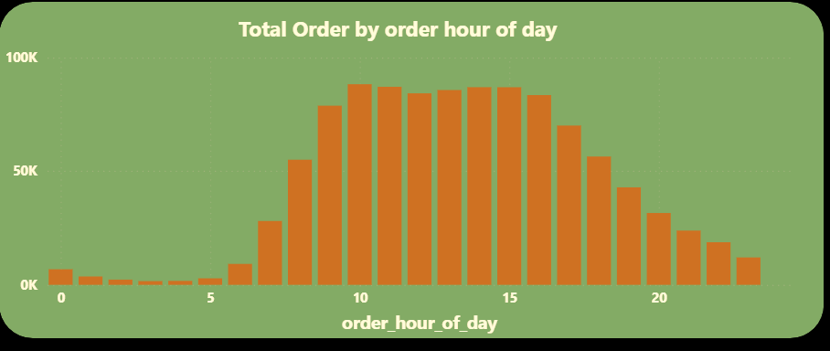
Busiest Time of day
Early Morning is Very Quiet (0:00 – 6:00)
.Orders are almost non-existent overnight
.Lowest activity happens between 2 AM – 5 AM
You don’t need many staff during these hours
Sharp Morning Surge (7:00 – 10:00)
·Orders spike rapidly starting around 7–8 AM
· Peak begins forming around 9–10 AM
This suggests morning demand (likely breakfast / early shopping

Slide 15
Continuation
Evening Decline (18:00 – 22:00)
.Orders drop steadily after 6 PM
. By 9–10 PM, activity is much lower
Reduce staffing gradually after 6 PM
Operations Optimization
.Schedule deliveries and logistics heavily during peak
.Prepare inventory before morning surge
.Consider promotions during:
.Low hours (early morning or late evening) to boost demand
Peak Demand Window (10:00 – 15:00)
· Highest order volume occurs between:
o 10 AM – 2 PM
· This is your busiest period overall
Critical time to:
· Increase staff
· Ensure inventory availability
· Optimize delivery/logistics
Gradual Afternoon Stability (15:00 – 17:00)
· Orders remain relatively high but start to plateau slightly
Still important, but less intense than peak

Slide 16
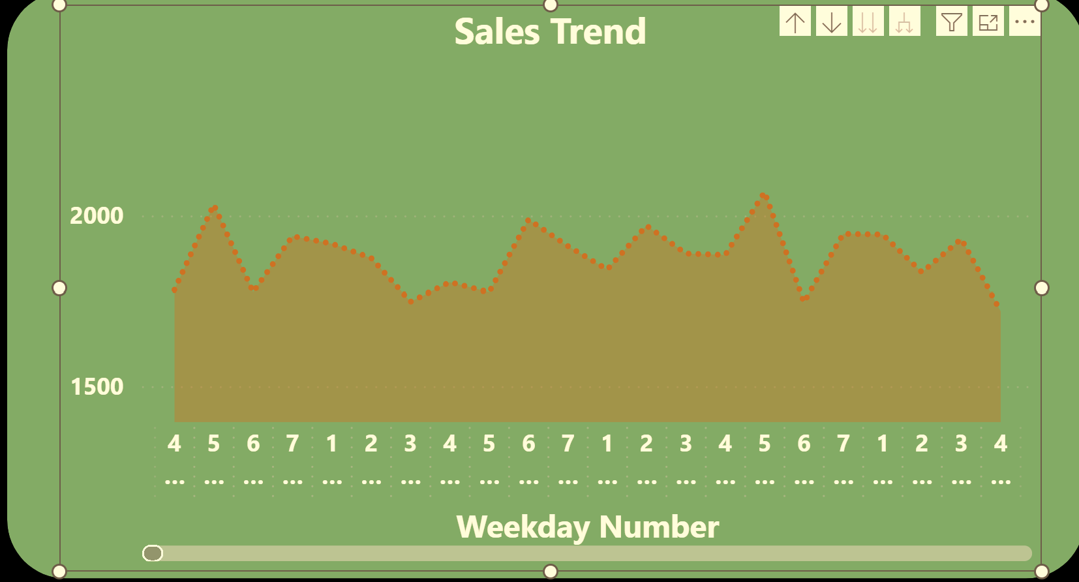
Daily Sales Trends by Total Quantity
Key Insights
Friday Peak: Customers place the most orders at the end of the week, suggesting strong demand before the weekend.
Early Week Weakness: Tuesday consistently shows the lowest order volume, indicating reduced customer activity at the start of the week.
Stable Decline: The drop is gradual, not sudden, which points to predictable customer behavior rather than random fluctuations.
Revenue Alignment: Since both revenue and quantity show similar downward trends, the issue is demand-driven, not just pricing

Slide 17
Continuation
Customer Behavior Analysis
Investigate why customers order less early in the week — is it lifestyle-driven, product availability, or marketing gaps?
Segment customers by order day to tailor offers (e.g., “Tuesday Saver Deals” for price-sensitive buyers).
Strategic Takeaway
Your business has predictable weekly demand cycles: strong on Fridays, weakest on Tuesdays. By capitalizing on peak days and stimulating demand on slow days, you can smooth out the curve and increase overall performance.
Recommendations
1.Leverage Fridays
a. Launch promotions, new product drops, or marketing campaigns on Fridays to maximize peak demand.
b. Consider offering “weekend bundles” or limited-time deals to capture momentum.
2.Boost Early Week Sales
Introduce Monday/Tuesday incentives (discounts, loyalty points, free delivery) to counter the slump.
a. Target marketing campaigns (emails, ads) early in the week to re-engage customers.

Slide 18
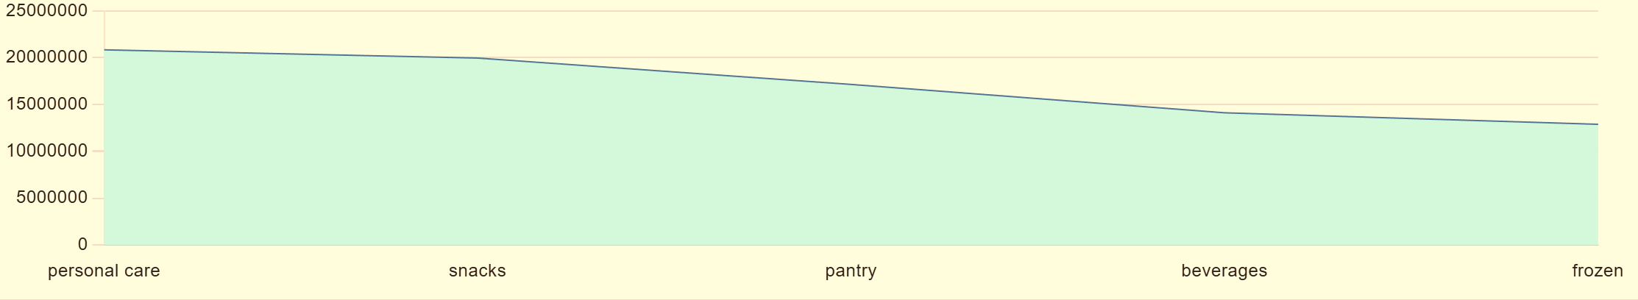


SQL ANALYSIS
Possible Reasons
Strongest category: Personal care leads with revenue slightly above 20M, showing it’s the most profitable segment.
Weakest category: Frozen products generate the lowest revenue, almost half of personal care.
Overall pattern: The line shows a steady downward slope, suggesting either declining demand or weaker positioning in categories beyond personal care.
Top 5 Department by Revenue

Slide 19
Top 5 Dept by Revenue (contd.)
Recommendations:
1. Leverage strong categories:
.Expand personal care offerings since it’s already performing well.
.Bundle personal care with lower-performing categories to cross-sell.
2. Optimize distribution:
.Improve cold-chain logistics for frozen products.
.Ensure wider availability of beverages and pantry items in high-demand regions.
Possible Reasons continue
Consumer preference: Customers may prioritize essentials like personal care over discretionary categories like frozen foods.
Distribution challenges: Frozen items often require specialized logistics, which could limit reach and sales.
Competition: Snacks and beverages are highly competitive markets, possibly eroding revenue.
Marketing focus: Personal care may have stronger branding or promotional support compared to other categories

Slide 20
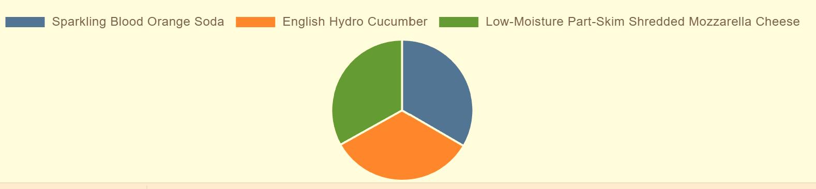
Top 3 Products Sold During Weekends
Insights
1.Balanced performance: All three products—Sparkling Blood Orange Soda, English Hydro Cucumber, and Low-Moisture Part-Skim Shredded Mozzarella Cheese—sold roughly the same number of units (around 110).
2.No standout leader: None of the products significantly outperformed the others, suggesting demand is evenly distributed.
3.Stable demand: The similarity in sales volume indicates consistent consumer interest across different product categories (beverages, produce, dairy)

Slide 21
Recommendations
1.Bundle strategy: Create combo deals (e.g., pairing soda with cheese or cucumber) to encourage cross-category purchases.
2.Targeted marketing: Since all products perform equally, test different campaigns (health-focused for cucumber, indulgence for cheese, lifestyle for soda) to see which resonates most.
3.Expand distribution: Ensure all three products are equally available in high-traffic locations, since none is lagging.
4.Upsell opportunities: Introduce premium versions (e.g., artisanal cheese, organic cucumber, craft soda) to capture higher margins.
5.Monitor trends: Keep tracking sales over time—equal performance now may shift if consumer preferences change seasonally.

Slide 22
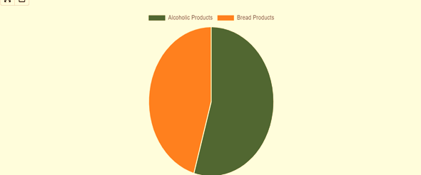
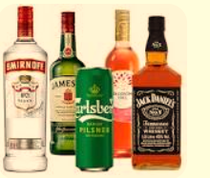
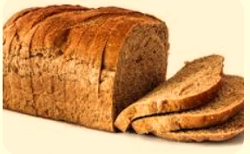
Profit Generated from Bread and Alcoholic Products
Alcoholic Products Dominate Sales
.Alcoholic products account for slightly more than half (55%)
.Bread products make up 45%
Alcohol is the leading category
Bread Still Significant
· Bread products are not far behind
·A 10% gap means:
Bread is still a core revenue driver, not weak

Slide 23
Contd.
Cross-Selling Opportunity
●Combine both categories:
Example:
●“Wine + Bread” bundles
●“Dinner packages”
Revenue Concentration Risk
●Heavy reliance on alcoholic products
If demand drops (regulations, supply issues), revenue could be affected
Growth Opportunity in Bread
●Since the gap is small:
You can easily close it with:
●Promotions
●Bundles (e.g., bread + spreads)
●Discounts

Slide 24
Products Not Sold
All Products were sold

Slide 25
Thank you

